Slide 1
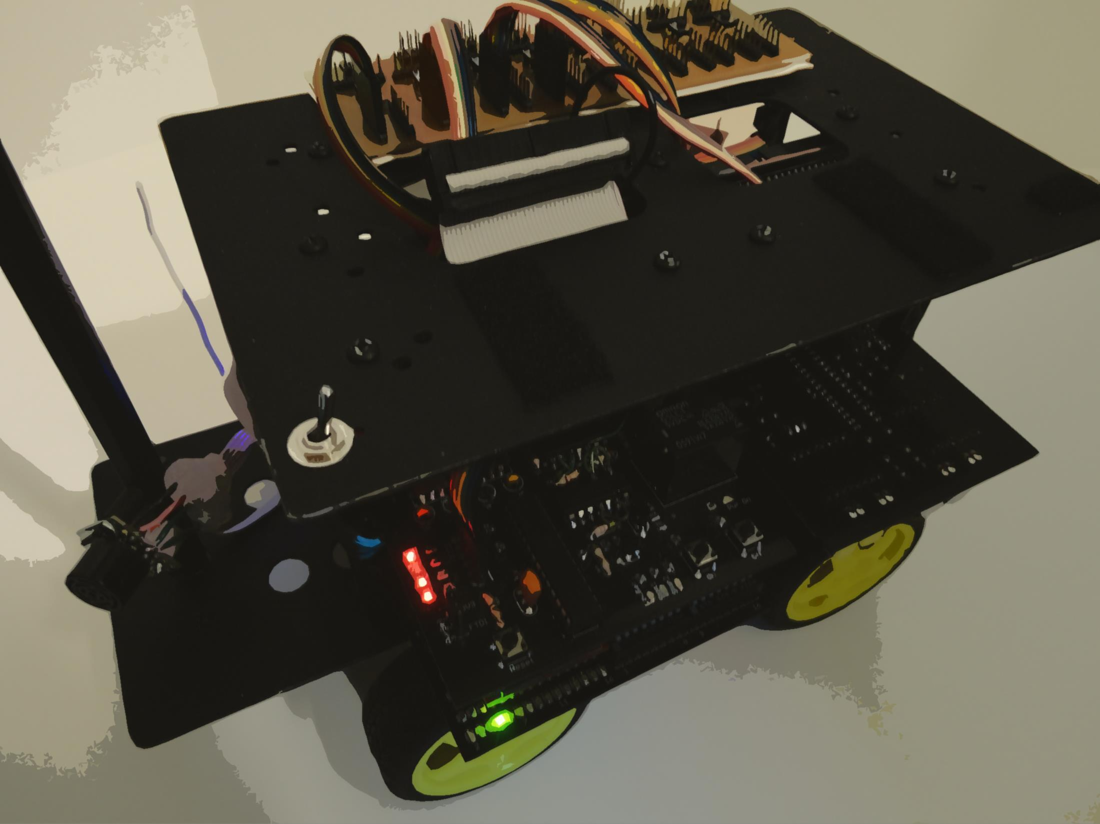
Autonomous
Robot Platform
ECE298 Paul Rayes

Slide 2
Topics
Topics
Goals
Work Done
Block Diagram
Next Steps
Failures / Lessons Learned

Slide 3
Overall Goal
Overall Goal
to develop a platform that simplifies getting into robotics by supplying mobility and communications

Slide 4
Overall Goals (partial list)
Overall Goals (partial list)
Cost under $500 (ideally under $300)
Easy to use
Navigates autonomously in an environment
Communicates wirelessly
Can have many robots working together
Can be used as a foundation for other projects
Divided goals into different versions

Slide 5
Version 1 Goals (partial list)
Version 1 Goals (partial list)
Reliable
Wireless communication
Detects and avoids obstacles
Creates a map of the environment
Goes to a point specified by the user
Basic base operational

Slide 6
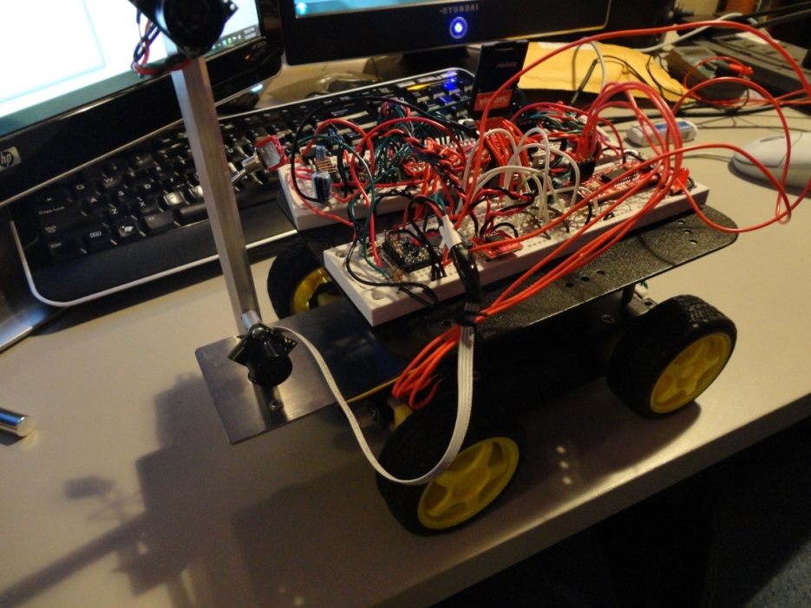
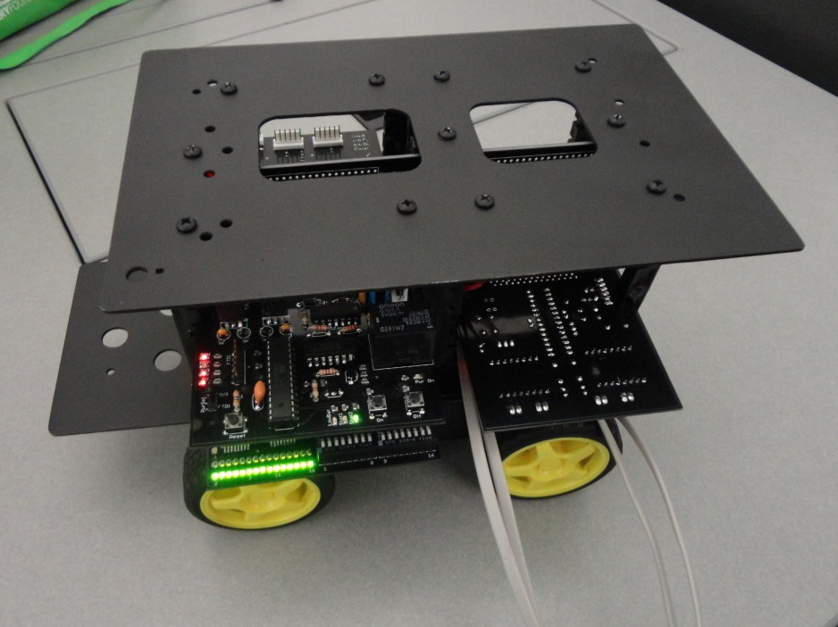
Previous Semesters
Previous Semesters
Spring 2012
Fall 2012
First prototype on breadboards
Basic obstacle avoidance
Custom circuit boards
Partially custom structure

Slide 7
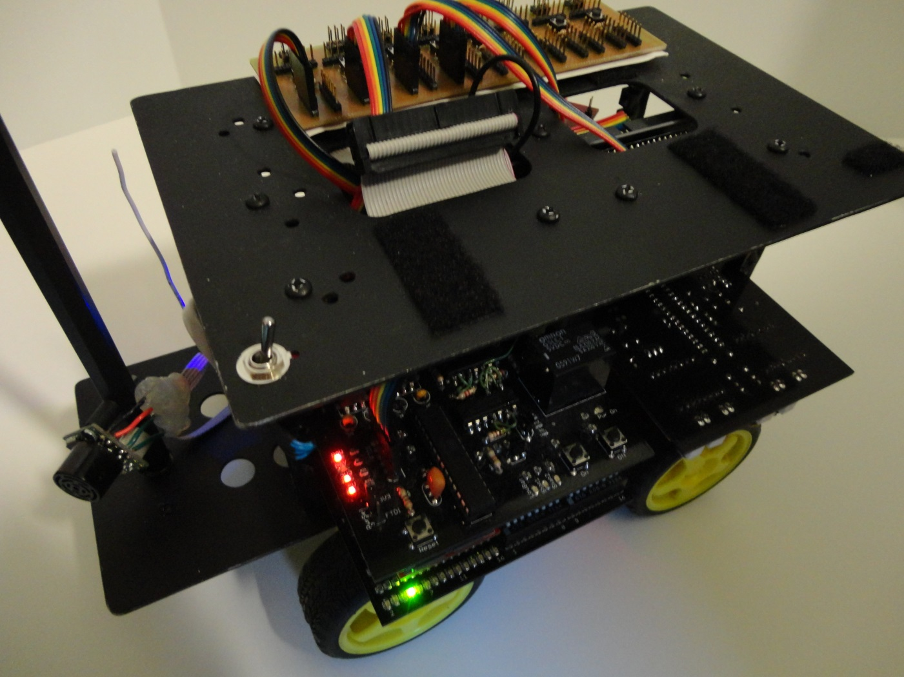
This Semester
This Semester
Robot as of right now
Has obstacle avoidance again and wireless

Slide 8
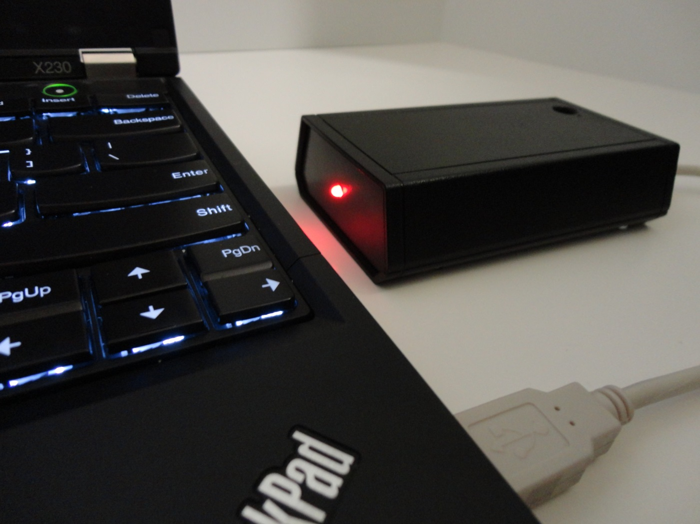
This Semester
This Semester
Base computer with wireless module

Slide 9
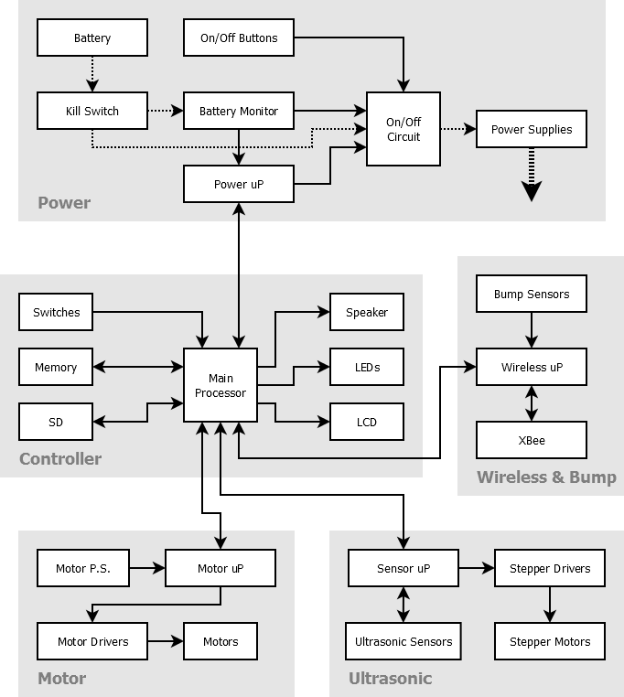
Block Diagram

Slide 10
Next Steps
Next Steps
Write the robot software
  Map creation
  Navigation
Additional hardware
  More permanent wireless
  Dead reckoning – compass, location estimation
  Bump sensors
  Multiple ultrasonic sensors to improve speed
Develop the base software

Slide 11
Next Step: Map
Next Step: Map
Create map with x,y positions
  “Explore Mode”: Robot explores, creating a map
Send map to base & display on screen
Able to click on point on map & robot will go there (or close to there)
Able to find itself after being power cycled and/or moved
Beacons at known positions
  one required, additional will improve accuracy

Slide 12
Failures / Lessons Learned
Failures / Lessons Learned
Don’t assume that because something looks like it should work, others have gotten it to work, the manufacturer promises it will work, and/or it has worked in the past, that it will work.
Dead reckoning is hard. Very hard.
Seeing what is happening really helps
  e.x., oscilloscope and logic analyzer

Slide 13
Questions?

